Slide 4
Types of Portfolios
Best Work Portfolio: Highlights and shows evidence of the best work of learners used for assessing student’s achievement, post-secondary admission and employability.
Growth Portfolio: Demonstrates an individual’s development over time. It focuses on academic or thinking skills, content knowledge or any other important area.
Showcase Portfolio: Highlights the best products over a particular period or time. For example a showcase portfolio in a class may include writings (essay, poems, story etc), a biographical piece or a literary analysis.

Slide 5
Types of Portfolios
Process Portfolio: Concentrates on the journey of learning rather than the final destination.
Evaluation Portfolio: Exhibits a series of evaluations of contents or courses on the basis of predetermined criteria or goals.
Online or e-Portfolio: May be one of the above portfolio types or a combination of different types, a general requirement being that all information and artifacts are somehow accessible online

Slide 6
Guidelines for portfolios entries
Determine the purpose
Identify physical structure
Determine sources of contents
Determine Students’ reflective guidelines and scoring criteria
Implementing Portfolio Assessment
Organizing a Portfolios
Student self-evaluation of contents
Peer assessment
Teacher evaluation of content and student self-evaluation
Student-teacher conferences
Follow-up

Slide 9
to

Slide 11
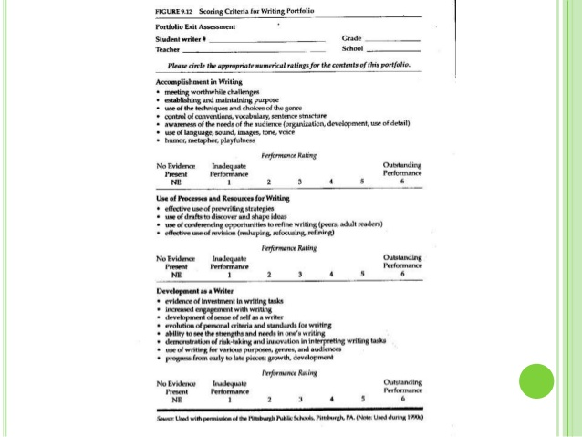

Slide 12
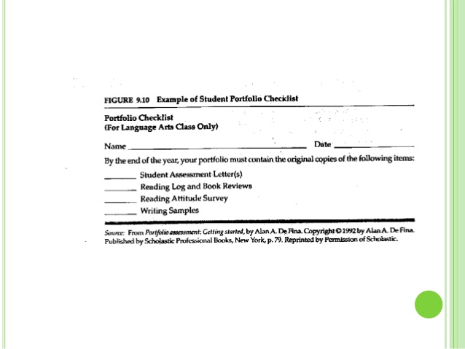

Slide 13
Review with Students:

Slide 14
Organizing a portfolio

Slide 15
Student self-evaluation of contents

Slide 16
Comments and feedback from peers

Slide 17
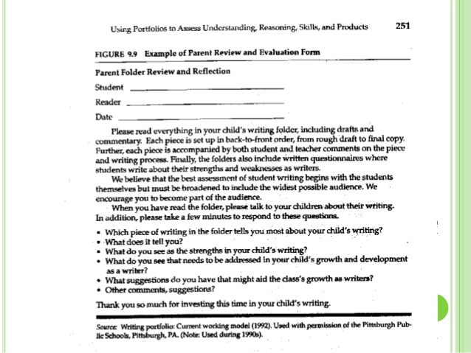

Slide 18
Teacher evaluation of content
Check list of content
Portfolio Structure Assessment: Selection of samples thoroughness, appearance, self-reflection and organization
Assessment of individual entries: use rubrics
Assessment of entire content: use rubrics

Slide 20
Wrapping up on assessing student learning

Slide 21
Follow-up
After portfolio is completed, it is a good idea to have an exhibition of portfolios and student led-parent-teacher conferences, in which students present their portfolios to their parents.

Slide 25
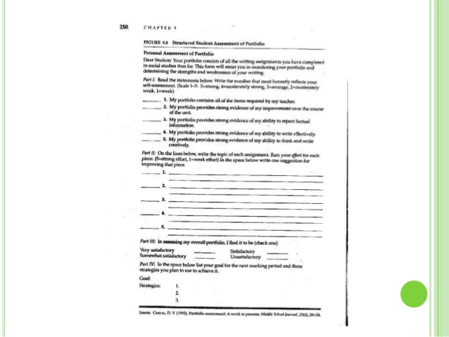

Slide 26
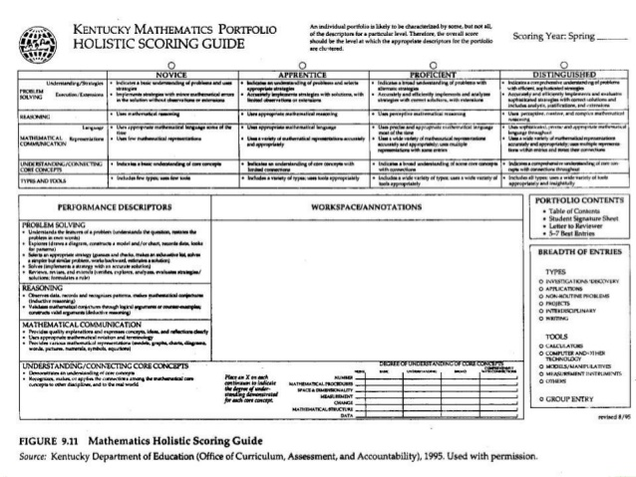

Slide 29
Conclusion

